Slide 1


AAGI Logo Guidelines
(Updated April 2026 to contain the updated logo block)

Slide 2

The Analytics for the Australian Grains Industry (AAGI) gives Australian growers an opportunity to be world leaders in analytics-driven decision making to drive efficiency and precision and support farm enterprise risk management.
AAGI is an investment of the Grains Research and Development Corporation (GRDC) and is led by three strategic partners Curtin University, the University of Adelaide and the University of Queensland. The strategic partners work with several project and associate partner organisations including leading Australian and international universities, federal and state government research agencies, and commercial technology and analytics providers, to expand the sector’s analytics capability and tackle the grains industry’s biggest challenges.
The new AAGI logo will be used in conjunction with the three strategic partners and GRDC. The wheat sheaf represents the Australian Grains Industry, while the two connector points represent data loading or data sensing points, often used when representing techy, data analytical organisations. The colours were chosen to look modern and techy.
The future is data driven. AAGI is a big investment that addresses the challenges and opportunities to bring Australian agriculture to the future, where it belongs with the rest of the world.
The Logo

Slide 3

The Logo Block
GRDC upfront as the major investment partner, separated with line
Strategic partners in alphabetical order
Comes in two lengths – portrait (above) and landscape (below)

Slide 4
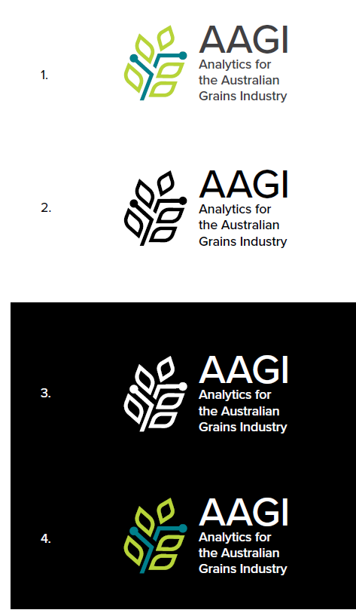
Logo Variations
The Analytics for the Australian Grains Industry logo is available in the following colour variations:
Full colour (AI, EPS, SVG, JPEG, PNG)
Mono (AI, EPS, SVG, JPEG, PNG)
Reversed (AI, EPS, SVG, PNG)
Full colour reversed (AI, EPS, SVG, PNG)

Slide 5
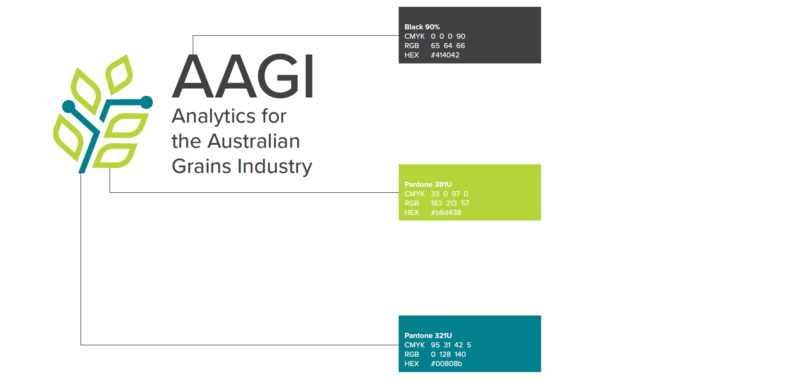
Colour Palette
To be used as an accent colour and not recommended for use in large colour blocks.
To be used as the main colour for AAGI material.

Slide 6
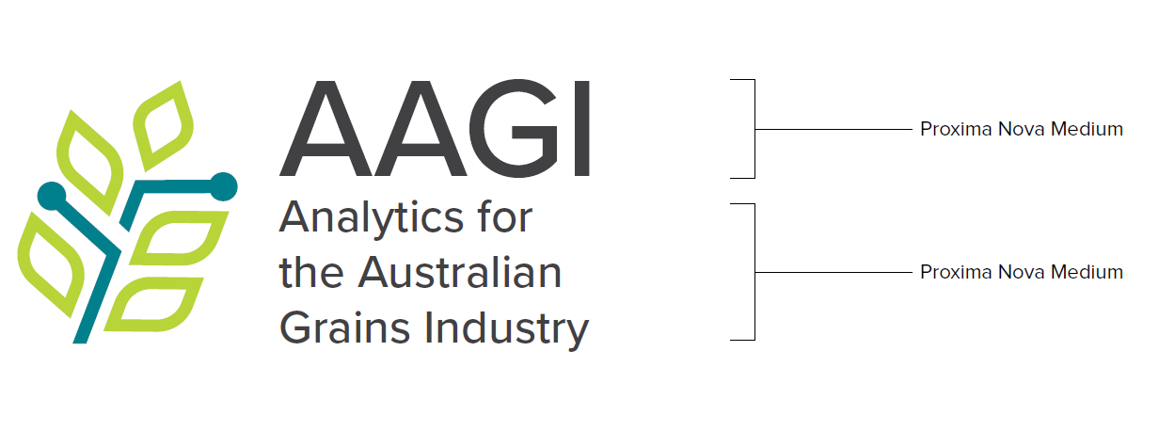
Fonts
TEXT 1
TEXT 2 (if text 1 is not available)
Proxima Nova Medium abcdefghijklmnopqrstuvwxyz ABCDEFGHIJKLMNOPQRSTUVWXYZ 1234567890
Arial
abcdefghijklmnopqrstuvwxyz ABCDEFGHIJKLMNOPQRSTUVWXYZ 1234567890

Slide 7




Minimum Size
The AAGI logo minimum size will ensure legibility when printed or published online.
The AAGI logo will frequently be used with the logo block, therefore the minimum size is based on GRDC/strategic partner guidelines.
Print: 3.36cm W
Online: 220px W
Minimum size of GRDC and strategic partners in block:
Print: 3.36cm W
Online: 220px W
Print: 3.36cm W
Online: 220px W
Print: 3.36cm W
Online: 220px W
Print: 3.36cm W
Online: 220px W

Slide 8
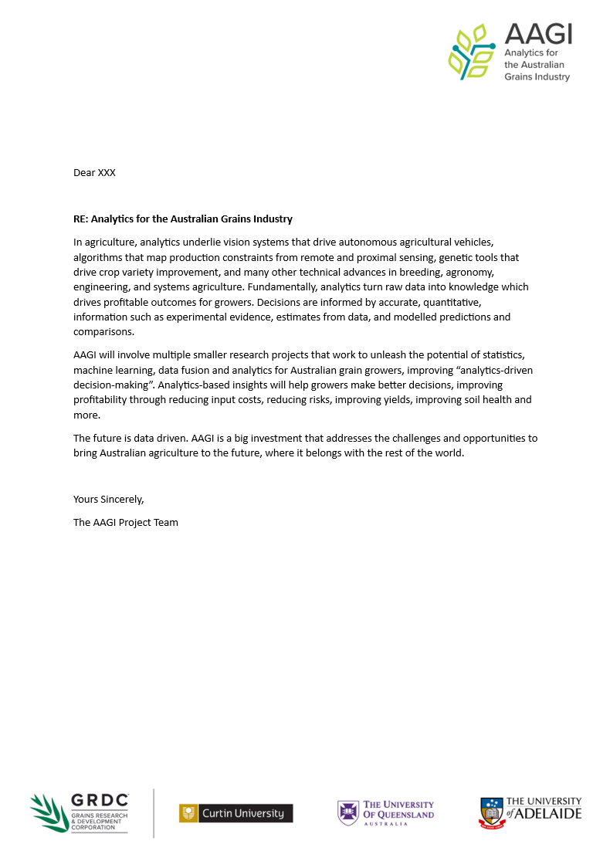

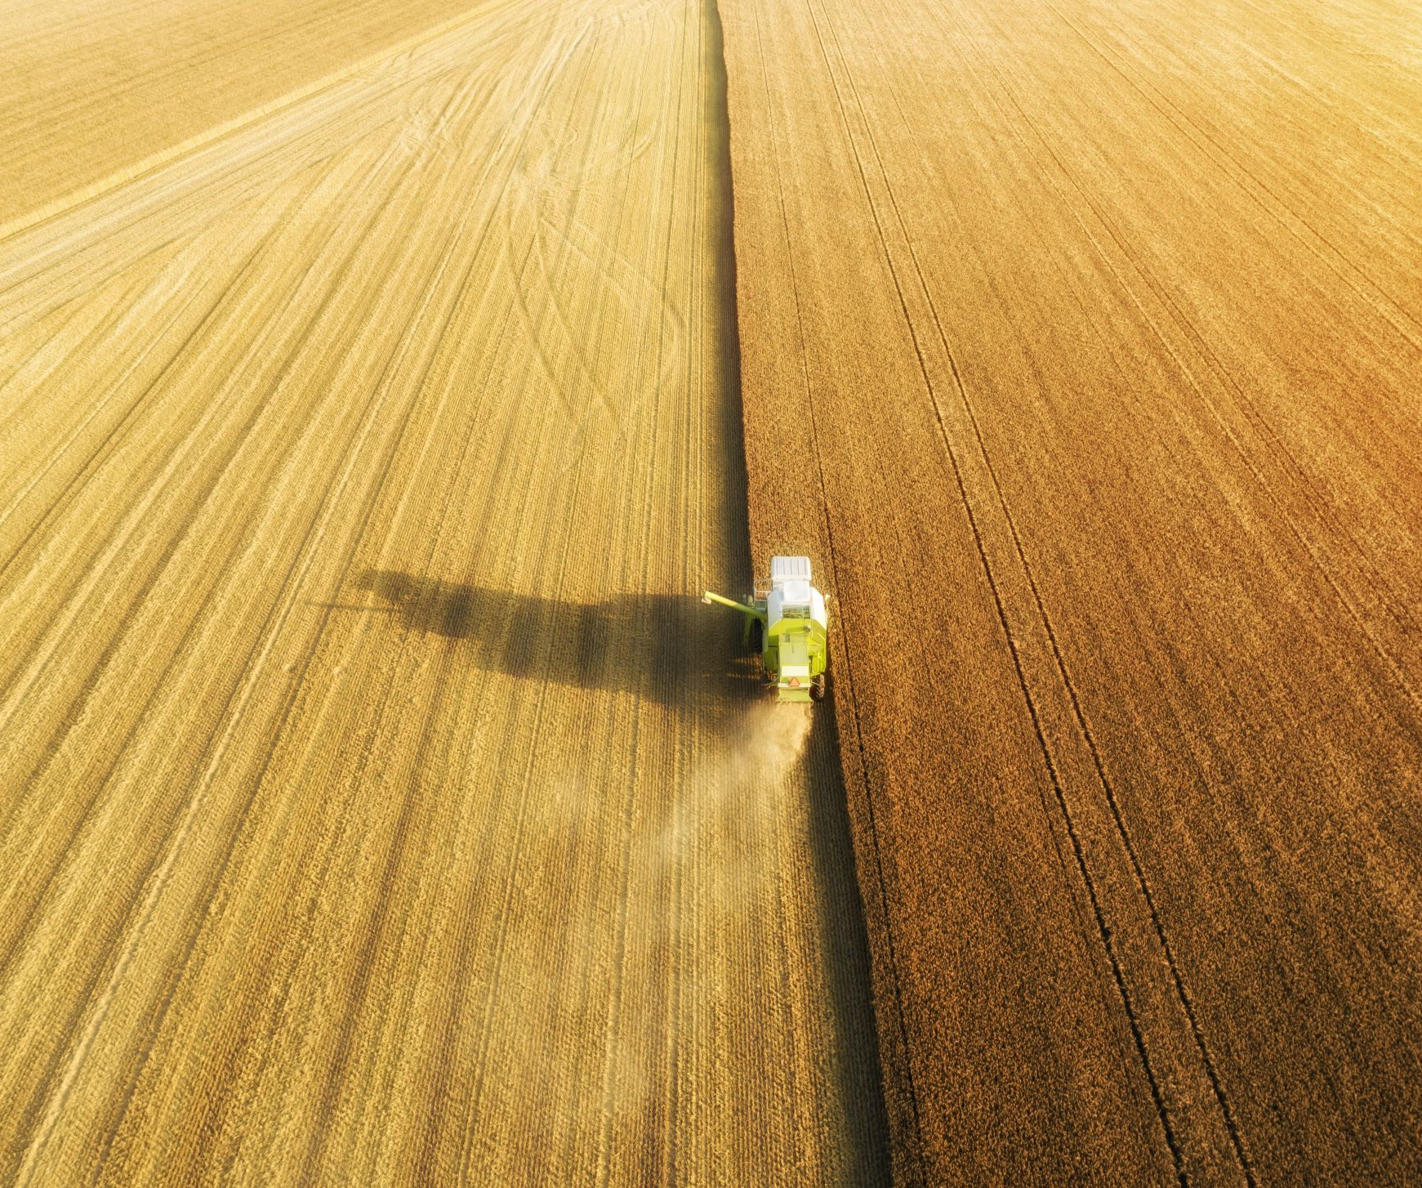

Placement of AAGI Logo
Pull up banner
Letterhead
AAGI is an investment of the Grains Research and Development Corporation (GRDC). It is led by strategic partners Curtin University, the University of Queensland and the University of Adelaide.

Slide 9

Cover Slide template
Presenter name/date

Slide 10
Slide template and table template
Slide Text
Example of a table with AAGI colour:
Table Heading
Table Sub-Heading

Slide 11



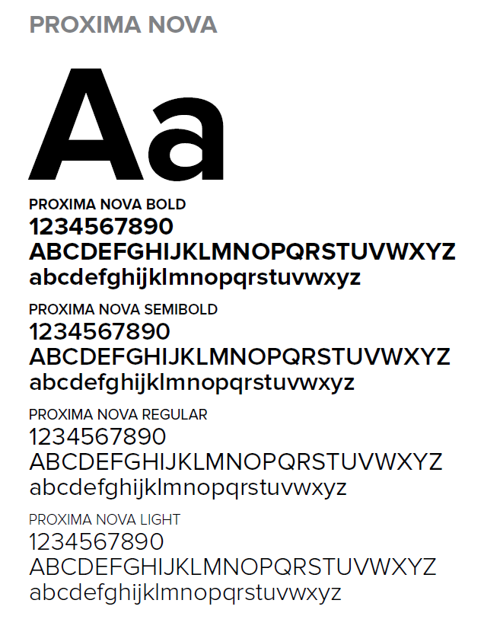
Logo do’s
Keep AAGI separate from the logo block – up high where it can look like a project, allowing GRDC and strategic partners to look like the ones running it.
On darker backgrounds, use the reversed version
Use the templates provided where possible. Consistency is what strengthens the brand and makes all partners look like a team working together.
Use “Proxima Nova” font when writing AAGI material. If not available, use “Arial”.

Slide 12

Logo don'ts
Don’t put the AAGI logo near GRDC/strategic partner logo-block – this is confusing! Best to keep logo separate and up high in a corner
Never change the logo colours
Never put AAGI under GRDC/strategic partner logos
Never alter the logo

Slide 13

The Logo Block - Incorporating a project partner
AAGI logo continues to be positioned up high and separate.
The logo block stays the same, with project partner positioned at the end.
An example in Portrait:
An example in Landscape:

Slide 14
If you have any questions about these guidelines, please contact:
Lisa Smith, CCDM Communications
Email: lisa.smith1@curtin.edu.au

